Slide 1
Describing information influence in social media with coupling inference methods
Master in Computational Science and Engineering Mathematics Section, EPFL
SUPERVISORS
Dr. Erik Hemberg
Prof. Una-May O’Reilly
Prof. Robert West
STUDENT
Cyril Vallez
Master Thesis Defense
March 6th, 2023

Slide 2
Introduction

Slide 3
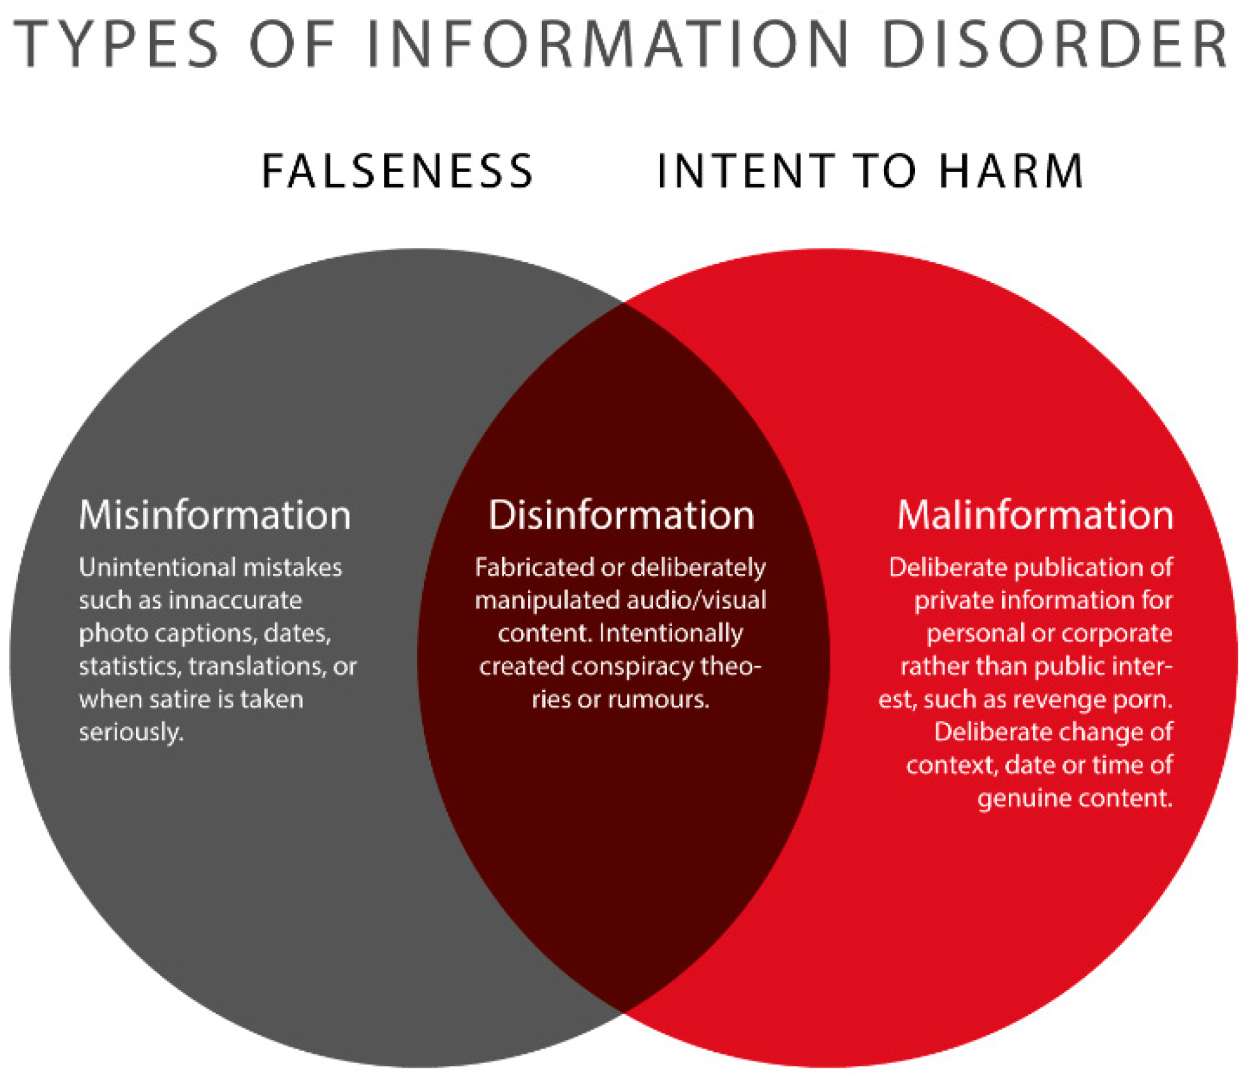
Terminology

Slide 4

Climate Misinformation/Disinformation
Very frequent on social media
Confused the public, led to political inaction, and to the rejection of mitigation policies
Increasing number of people rely almost exclusively on social media for getting news

Slide 5
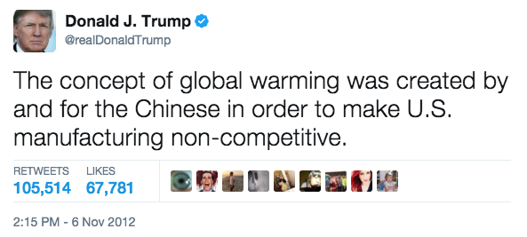
From Whom?
Individuals

Slide 6
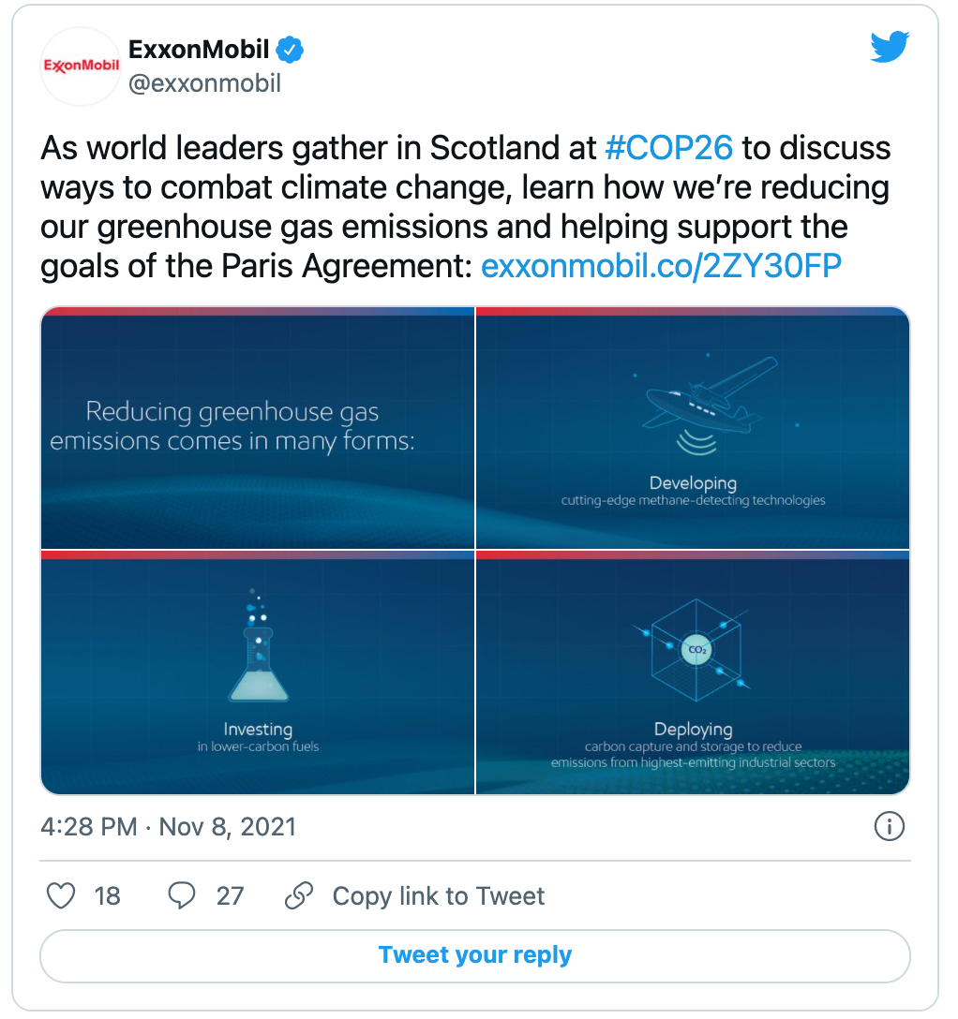
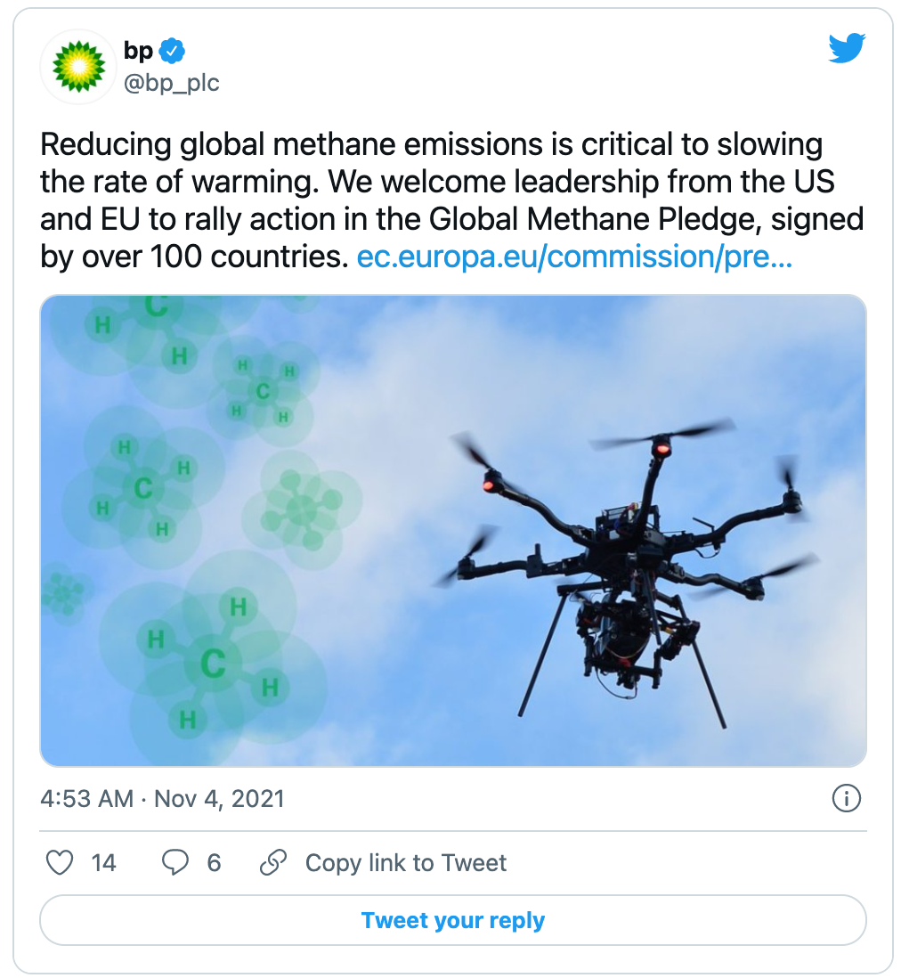
From Whom?
Individuals
Companies

Slide 7
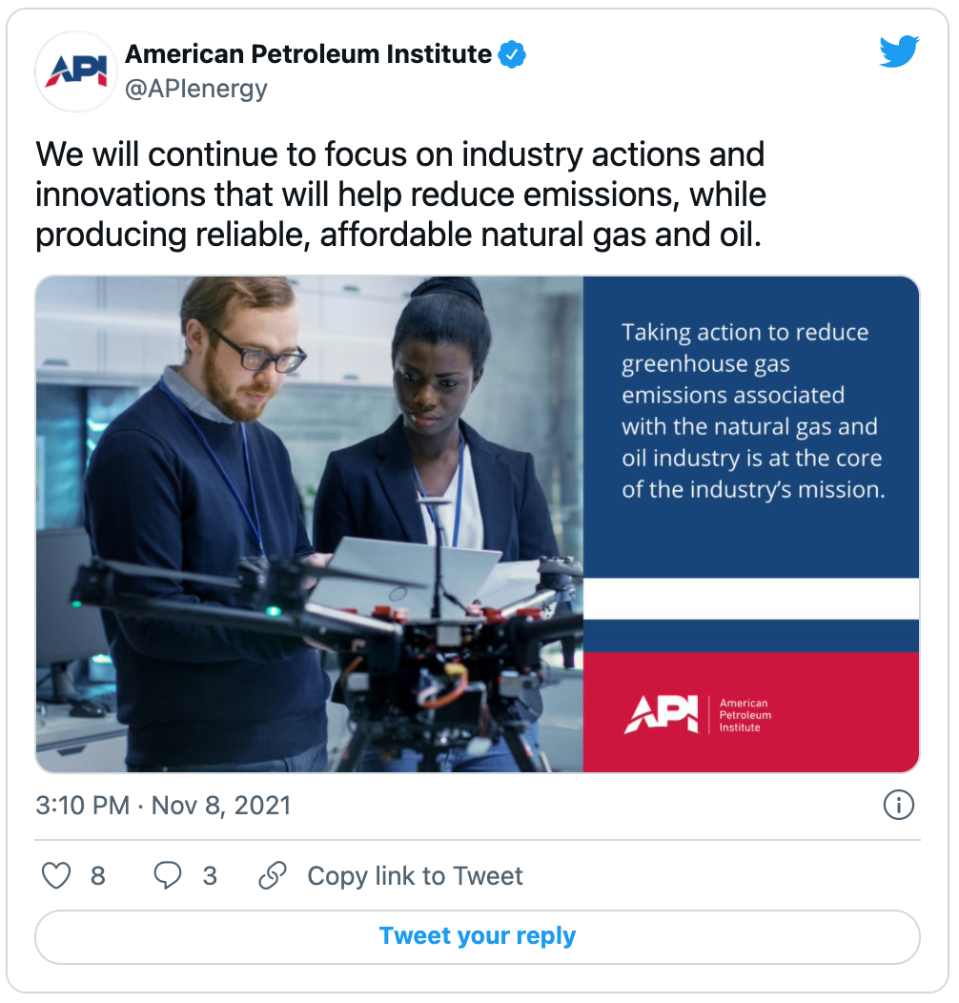
From Whom?
Individuals
Companies
Institutions

Slide 8
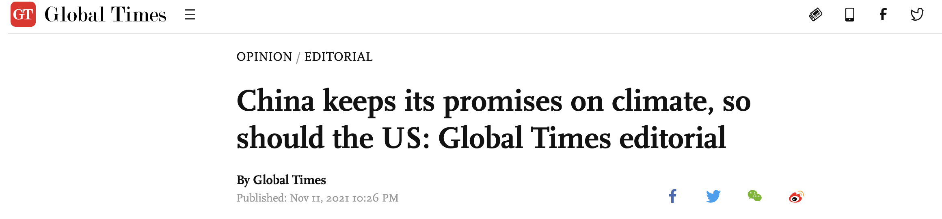
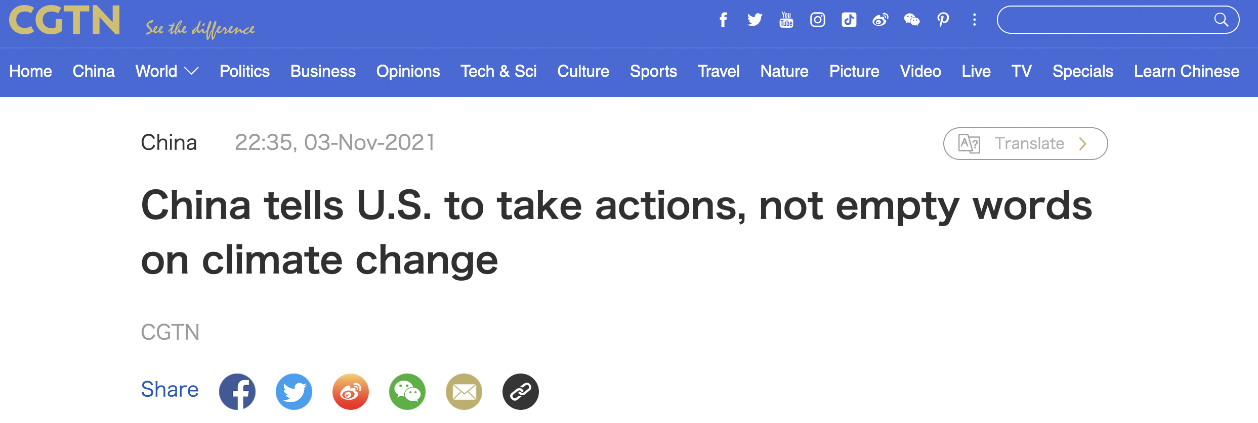
From Whom?
Individuals
Companies
Institutions
States
China-controlled media

Slide 9
Goal & Motivation

Slide 10
Detection of disinformation campaigns
Quantify the influence between users on Twitter
Create a system able to capture influence attempts relating to (climate change) disinformation between users on Twitter.
Derive new influence measures describing the amount of disinformation shared by the users on Twitter.

Slide 11
Methodology

Slide 12

Datasets
COP26: all climate-related tweets containing a URL around COP26.
COP27: all climate-related tweets containing a URL around COP27.
Skripal: all tweets related to the Skripal poisoning in 2018. It is a well known case of disinformation campaign. Used for comparison to a known case.
Control: all climate-related tweets containing a URL at random dates.
Twitter API query to obtain climate-related tweets

Slide 13
Data processing
Only tweets from users who posted at least 3 tweets
NewsGuard ratings: 8145 unique news domains

Slide 14
Time series creation

Slide 15
Influence graphs
Coupling Inference Methods

Slide 16
Coupling Inference Methods
Transfer Entropy (TE)
Joint Distance Distribution (JDD)
Need to binarize the time series
Naive estimation of state probabilities
Need to decide on a threshold
Well known and supposedly more robust
Use original (standardized) values
Based on distances
Formulated as hypothesis testing
Supposedly less robust

Slide 17
Influence measures
Outdegree: for each node (actor) in the influence graph, outdegree directly indicates how many other actors this actor influenced.
Betweenness: indication of how well one actor serves as a bridge to influence many other users.
These measures can be fine-grained and derived for each edge type in the graph:
T-T: echo chamber of trustworthy news sharing.
T-U: credibility cross-over of trustworthy to untrustworthy news sharing
U-T: credibility cross-over of untrustworthy to trustworthy news sharing
U-U: echo chamber of untrustworthy news sharing.

Slide 18
Results

Slide 19
Action distributions
Proportion of untrustworthy news sharing larger during Skripal
May be a hint of underlying disinformation campaign
Skripal dataset
COP26 dataset
COP27 dataset
Notes:
TODO: put them at same scale

Slide 20
Comparison JDD-TE influence graphs
JDD detects large spikes of influence of the untrustworthy types during COP26.
No difference with the control for TE.
JDD on the COP26 dataset
TE on the COP26 dataset

Slide 21
One influence measure to govern them all?
Weak overall correlations
Only outdegree and betweenness exhibit relatively high correlation.
Link between follower and retweet: larger audience helps to spread message.
Each measure is in fact capturing different types of information, and influence definitions.
Correlation matrix between influence measures for JDD
on the COP26 dataset

Slide 22
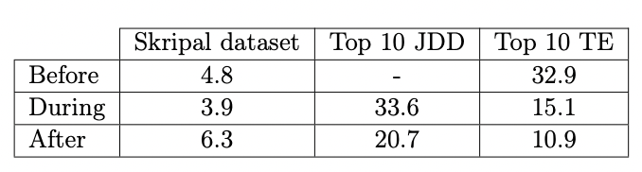
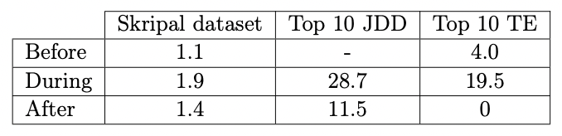
What do influential people share?
Mean number of mentions of “rt.com”
Mean number of mentions of “sputniknews.com”

Slide 23
Conclusion

Slide 24
Conclusion
We explored two coupling inference methods to derive influence graphs, and detect disinformation campaigns on social media.
Climate change related data around the COP26 and COP27. Well-known case of disinformation with Skripal.
Influence measures have relatively low correlation between themselves, showcasing that they do not capture the same types of influence.
JDD results in sparser influence graphs, but finds individuals who seem more active in spreading disinformation than when using TE.

Slide 25
Future work

Slide 26
Thank you!

